Slide 1
UN Population data
Don Geethanjali Padmaperuma
DATA 607 Final Project Presentation

Slide 2
introduction
In this final project, I am using UN population data in order to find answers to my research questions,
(1) Which Region has the highest Life Expectancy?
(2) Is there a increase/decrease Population, fertility rate and infant mortality rate in these regions?
I have been always curious and interested in the work that United Nation does as a leading Non-profit organization. I have worked for them as an Intern and have seen the amount of work they do for the under-developed countries. As an international organization UN holds large number of world statistics. Population data are one of those important statistics and interesting to learn.

Slide 3
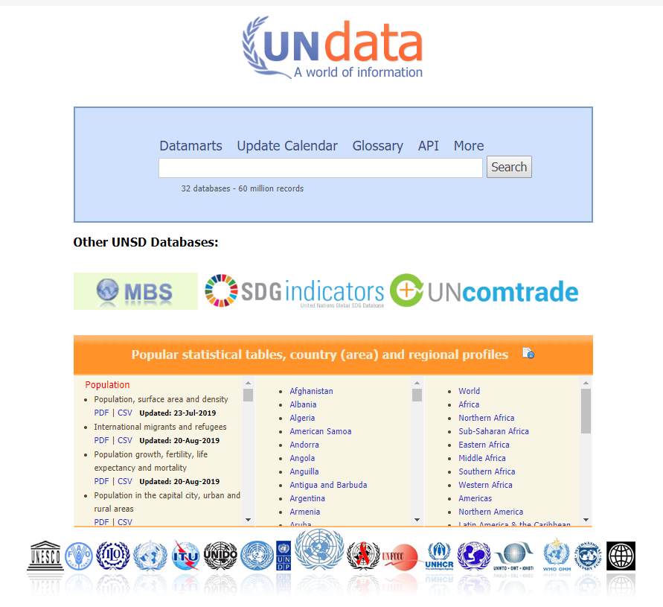
Data collection
These data was obtained from the United Nations Database called UNdata:A world of information.
UNdata is a web-based data service for the global user community. These data are maintained by the Statistical Division of the Department of Economics and Social Affairs (UN DESA) of UN Secretariat. Most of the data sourced by UN partner organization such as UNICEF, UNDP, UNHCR, WHO etc.

Slide 4
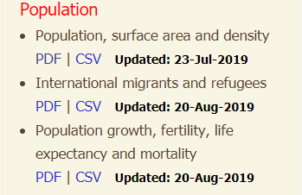
Data Sets
For this project I am using two data sets.
Population, surface area and density dataset
Population growth, fertility, life expectancy and mortality dataset
Both files comes in .csv format making it easier in the tidying process.

Slide 5
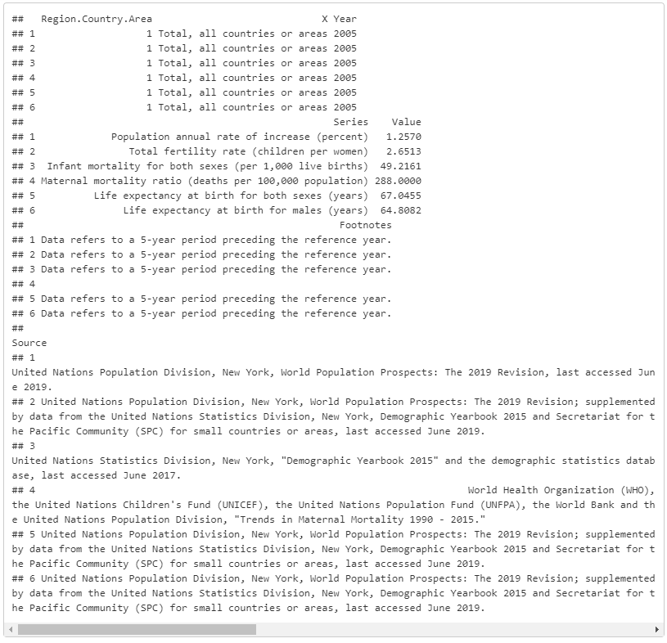
Summary statistics for population growth data

Slide 6
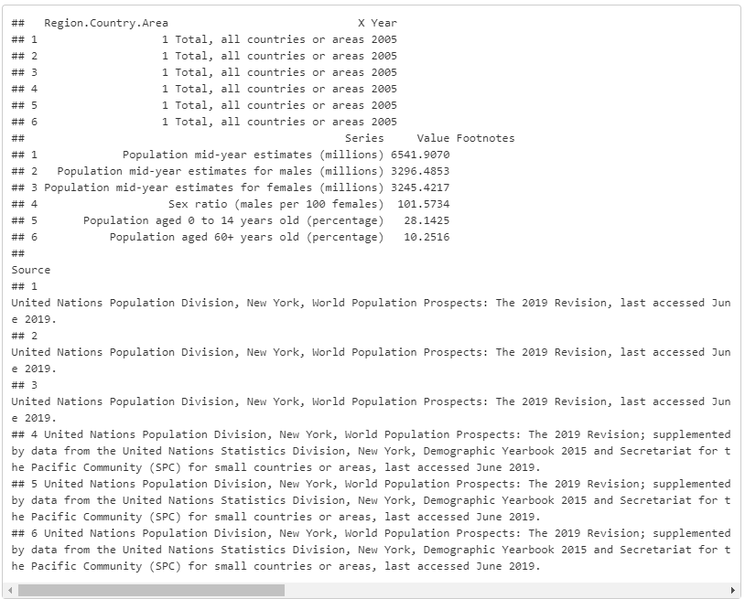
Summary statistics for population data

Slide 7
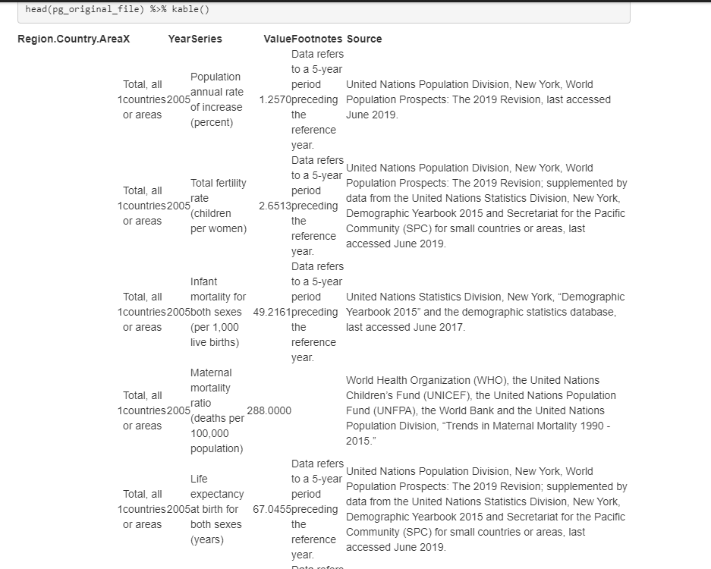
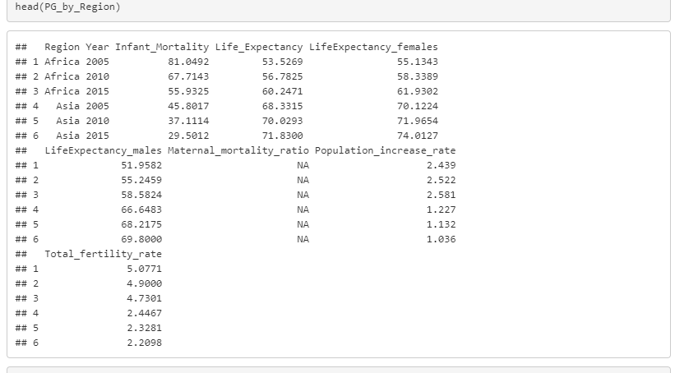
Tidying population growth dataset
before
after

Slide 8
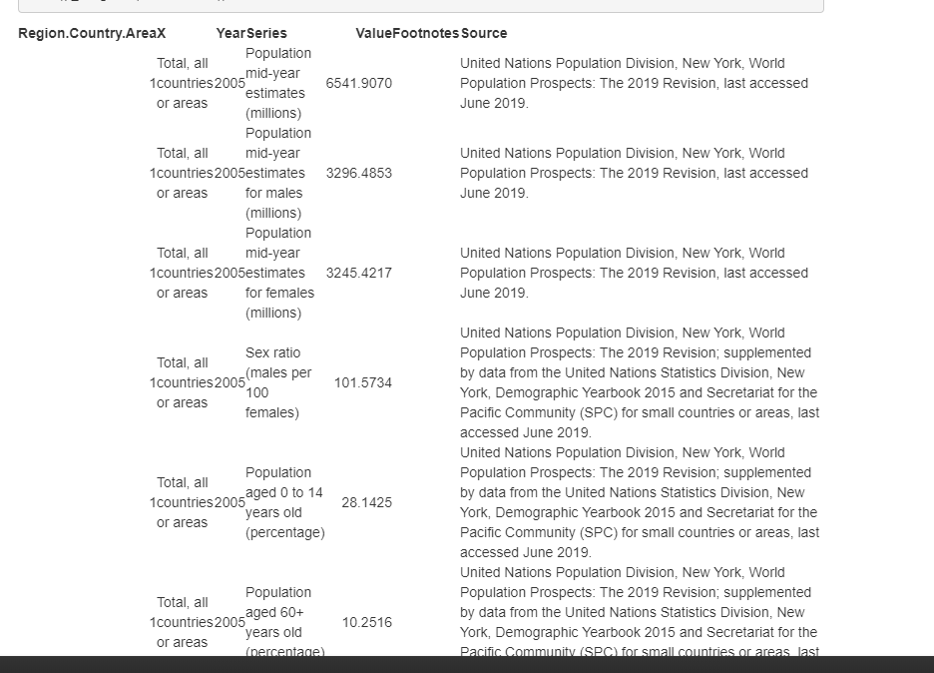
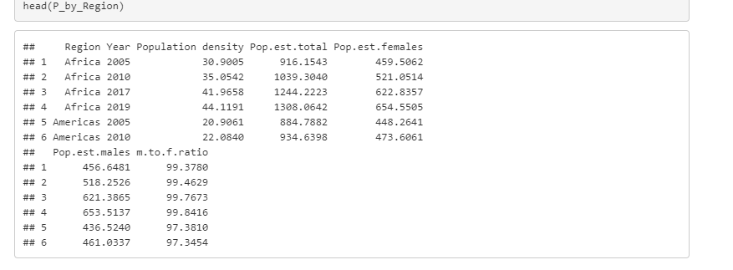
Tidying population dataset
before
after

Slide 9
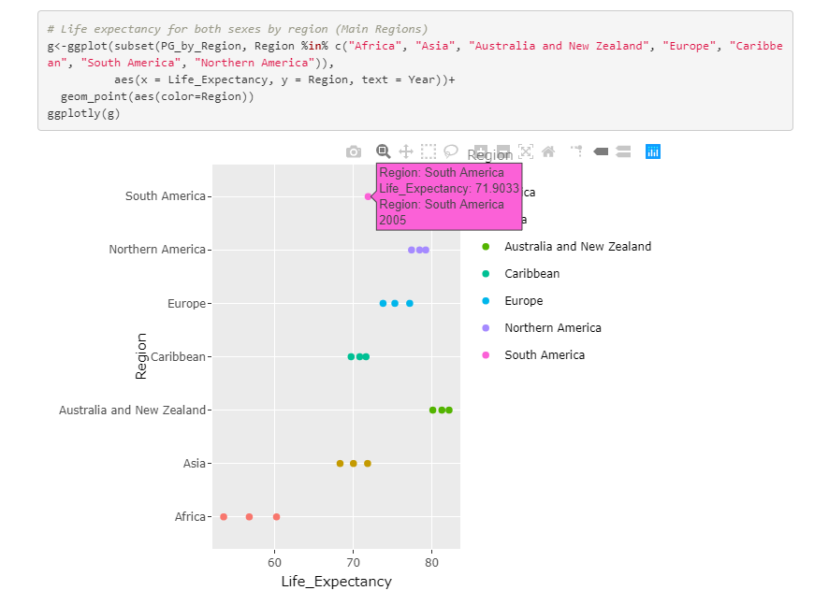
Life expectancy
Data visualization with population growth data.
This interactive graph shows life expectancy for main regions such as
Asia, Africa, Australia & New Zealand, Caribbean, Europe, N. America and S. America.
Highest Life expectancy is recorded in Australia and New Zealand regions.

Slide 10
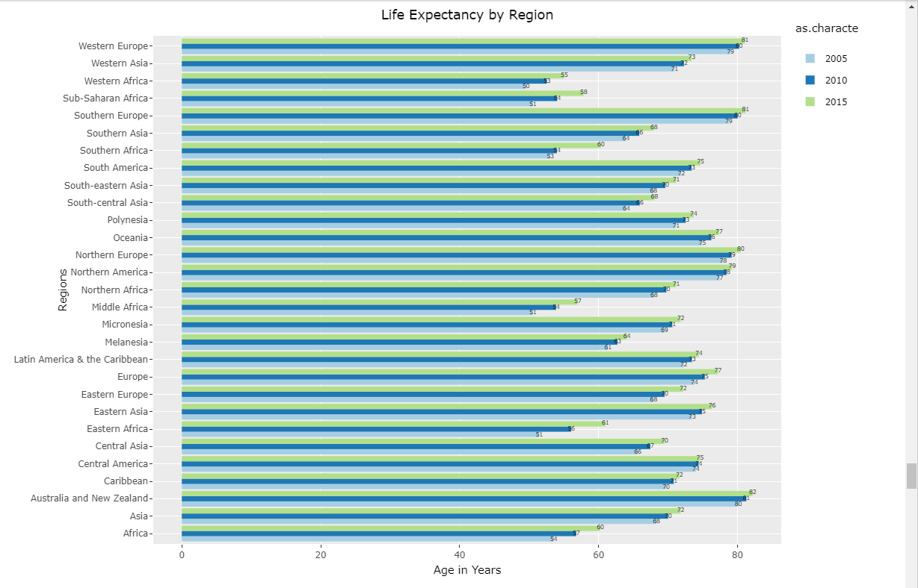
This graph has all the regions and their Life Expectancy for the years 2005, 2010 & 2015
Answer for Research Question 1
Which Region has the highest Life Expectancy?
Above graph for Life expectancy by region clearly shows that Australia and New Zealand region with the highest life expectancy of age 82. This region is on the top for the last 15 years with highest Life expectancy over age 80.

Slide 11
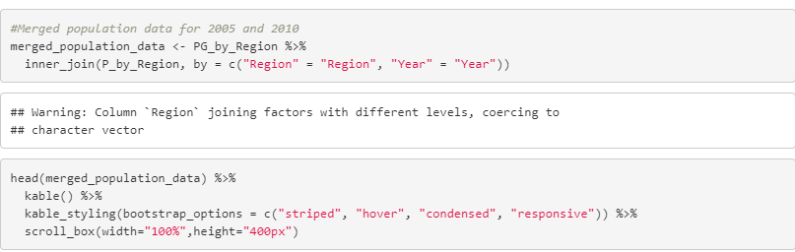
Merging two datasets Comparing Population Growth and Population data to see the relationship between Fertility Rate, Infant Mortality and Population growth rate.

Slide 12
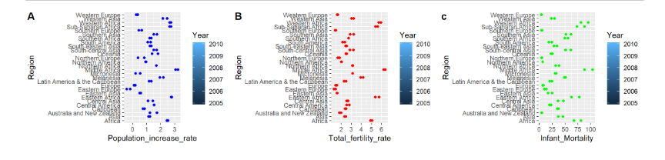
Side by side comparison
Fertility rate, which shows the children per woman, has clearly declined within the time frame 2005 to 2010. This has impacted on slow increase in population increase rate. Also Infant Mortality rates are also have declined. This reflects in decreased fertility rates as well.

Slide 13
Answer for Research Question 2
Is there a increase/decrease Population, fertility rate and infant mortality rate in this region?
Years Infant.Mortalit Pop.increase Fertility
Australia and New Zealand 2005 5.0247 1.242 1.8043
Australia and New Zealand 2010 4.5033 1.741 1.9850
Infant Mortality rate decreased while population and fertility rate increased. This is a good sign and probably a good indicators for their high life expectancy in that region. Overall all the regions have decrease in infant mortality and increase in population increase and fertility, just in a lower speed than it used to be.

Slide 14
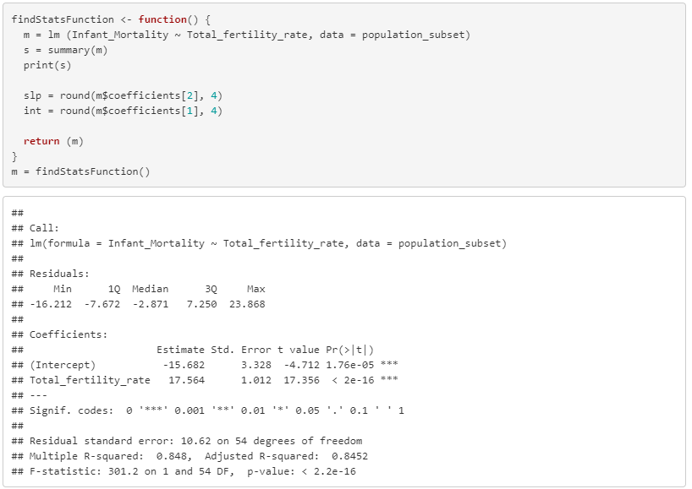
Correlation analysis
Linear dependence between two variables, Infant mortality and Fertility rates.

Slide 15
Hypothesis Testing for Infant mortality and fertility relationship
Null Hypothesis - There is no relationship between Infant Mortality and Fertility Rate
Alternative Hypothesis - There is a relationship between Infant Mortality and Fertility Rate
Here the multiple R value is 0.9209 which shows that there is significant correlation between Infant Mortality and Fertility Rate. Also the value of R square is 0.9209 which shows the extent to which the Infant Mortality affect the Fertility Rate.
Therefore, we reject the null hypothesis (H_0) and accept the Alternative hypothesis (H_A).

Slide 16
reference
https://data.un.org/
https://ourworldindata.org/

